Slide 1


InFocus AI
InFocus AI
Let AI create your perfect life!

Slide 2
Can you have it all?...

Slide 3



Problem
Big goals cause procrastination, breaking them into smaller tasks causes cognitive overload
Scheduling is time consuming, work-life balance is hard to achieve
Productivity tools are not personalised

Slide 4
Solution - InFocus AI
An AI powered smart life planning tool, that breaks your goal into smaller tasks, learns your behavioural patterns and plans your perfect schedule
FILLS YOUR CALENDAR BALANCING ALL YOUR PRIORITIES
BREAKS YOUR GOALS INTO SMALL TASKS
LEARNS AND IMPROVES SCHEDULING

Slide 5
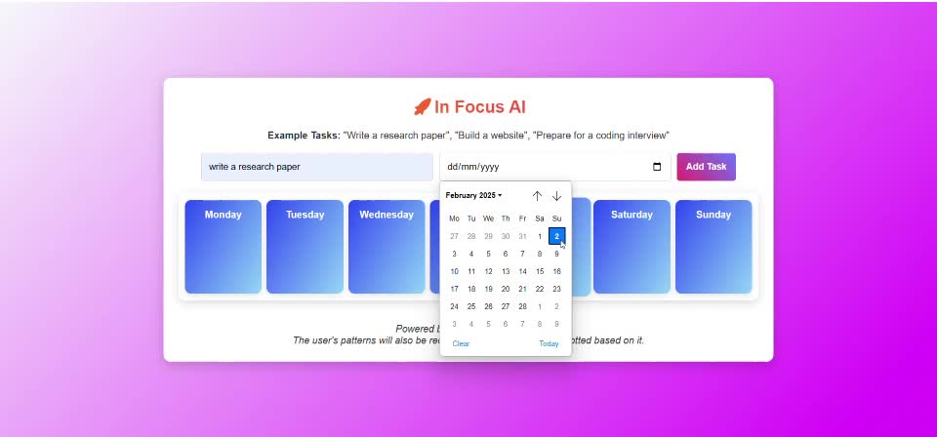
Demo

Slide 6
Strategizing Goals
Note Taking
Community
Next Step ->> Lifestyle Superapp
Collaboration
Analytics

Slide 7
All we ask is £100,000

Slide 8

InFocus AI
Thank you
Contact Us
Dr Fariza
CVO
LinkedIn

Slide 9





Our Team
Dr Fariza
Sonal
Moulish
CVO
Finance
Software Engineer
Shanky
Sam
Software Engineer
Software Engineer

Slide 10

01
Launch an exclusive Discord community to engage early adopters, gather feedback, and create buzz and later offer free premium access to the first 10,000 users to drive urgency and viral adoption.
02
Incentivize growth by offering a £5 referral bonus or free premium unlock for users who invite friends and complete tasks.
Marketing Strategy
03
Partner with TikTok, YouTube, and Twitter influencers in the productivity and self-improvement niche to drive awareness and credibility.
04
Implement leaderboards, streaks, and AI-driven challenges to increase retention and encourage daily app usage.

Slide 11
Target Market

Slide 12

Target Market
The targeted Market as per Jan 2025
10%
$ 13.8 B
TAM
20%
$ 6.9 B
SAM
$ 900 M
70%
SOM
Notes:
Visual Breakdown of the Pyramid
Top 10% (SOM):
Early adopters converting to paid users via freemium and premium plans.
Middle 20% (SAM):
Broader audience of productivity app users seeking AI-powered solutions.
Bottom 70% (TAM):
The total market for AI productivity tools, including enterprise solutions and global regions.

Slide 13
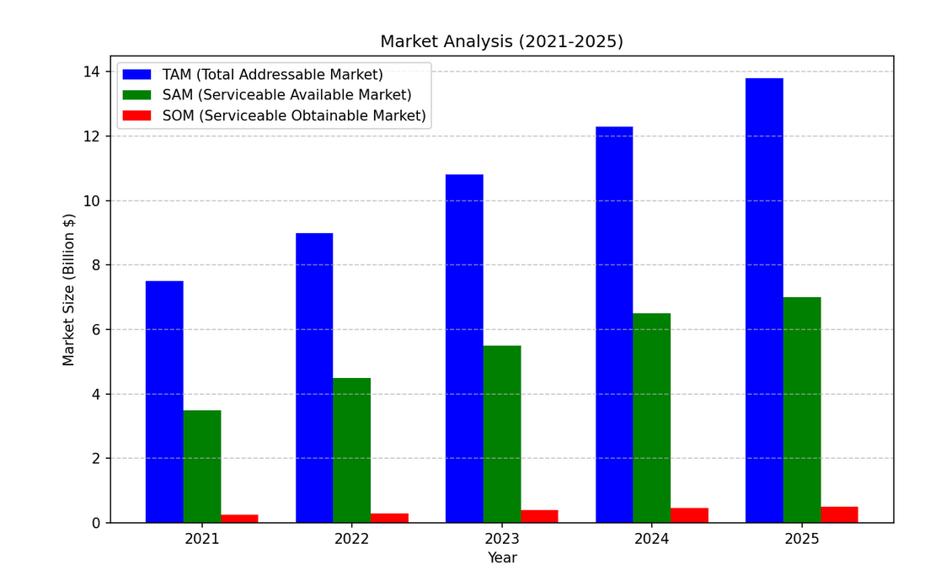
Market analysis
The global AI productivity market is projected to grow from $7.5 billion in 2021 to $13.8 billion by 2025 (25.8% CAGR).”
Key drivers include:
The rise of remote work.
Growing demand for personalized productivity tools.
Increased adoption of AI scheduling and task automation solutions.

